Slide 1
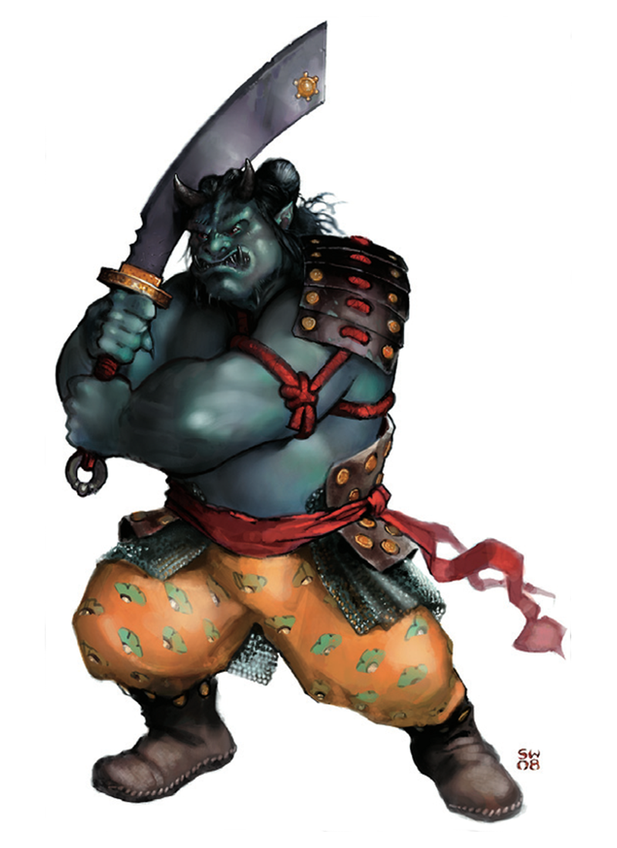
Hell Quiz Console Game
2015 C# Part 2 Team “Ogre Mage”
Telerik Academy
Ogre Mage

Slide 2

The Team
1. Иван Колев (INKolev) 5. Стела Матеева (Stelamat)
2. Даниел Попов (dany90) 6. Елена Ганчева (eagancheva)
3. Йордан Канчелов (jkanchelov) 7. Цветан Цонев (tsetsin)
4. Мария Стефанова (MariyaSteffanova) 8. Марио Койчев (mario123)

Slide 3
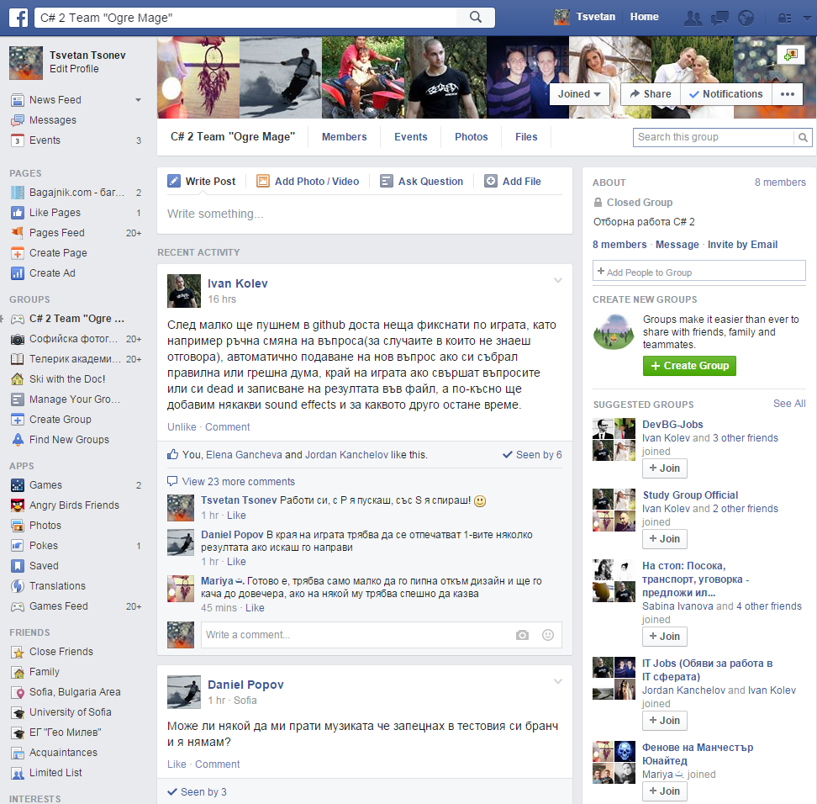
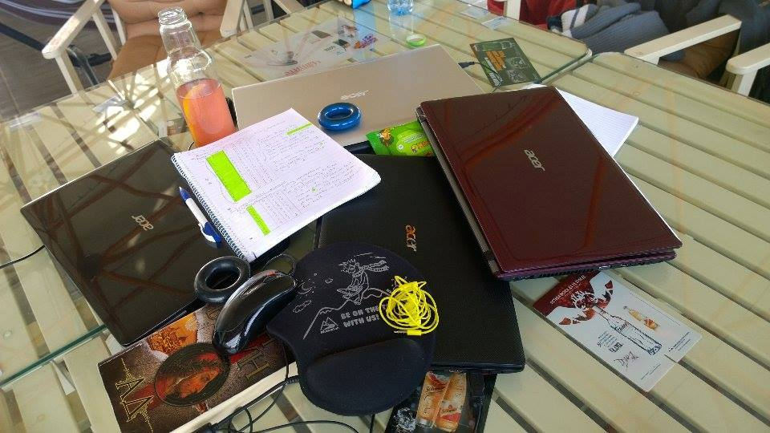
Communication
Facebook Group
Academy Meetings

Slide 4
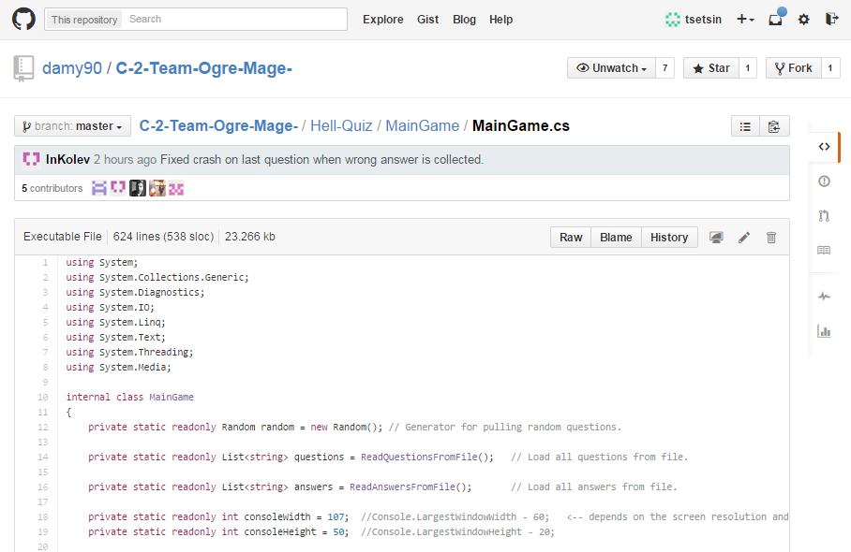
Team Collaboration
GitHub
https://github.com/damy90/C-2-Team-Ogre-Mage-

Slide 5
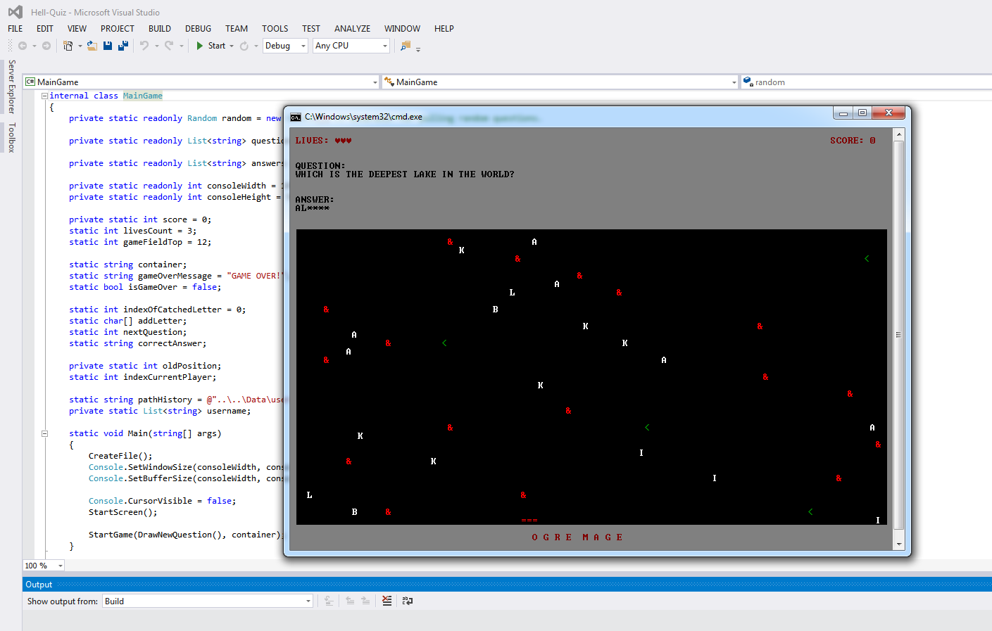
The Project
The project represents a console game called “Hell Quiz” written in the C# programming language. The game is similar to the popular “Falling Rocks”, but offers a unique user experience. It tests your common knowledge, skills and instinct of self-preservation.

Slide 6
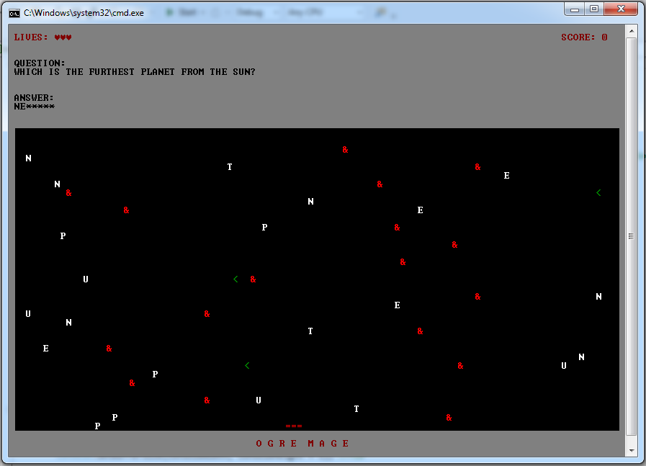

Gameplay
Answer questions
Avoid obstacles
Save your lives
Make high scores

Slide 7
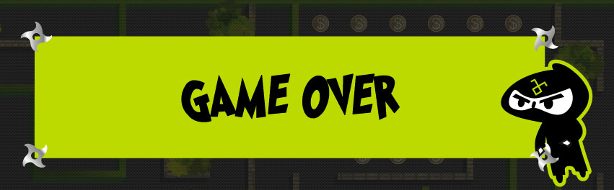
Thank You!

